Slide 1

ECE 281 Lab 1
Maj Walchko
1

Slide 2
Lab 1 Overview
You will create a 7 segment display decoder
You will need to modify the template to create:
sevenSegDecoder.vhd (implementation)
Implements the truth table
sevenSegDecode_tb.vhd (simulation)
Tests your file above
top_Nexys2.vhd
Allows you to run your sevenSegDecode.vhd on the real hardware

Slide 3
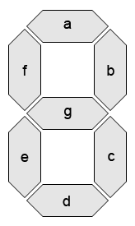
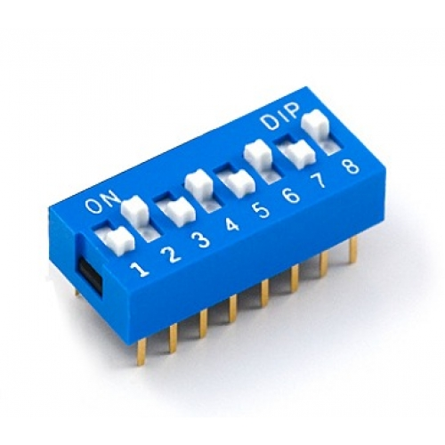
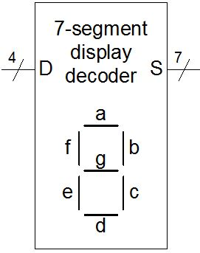
Overview
Simulation
sevenSegDecoder.vhd
---------------------------------
Import libraries
Define ports in/out
Declare internal signals (wires)
Map internal signals to outputs
Architecture logic
sevenSegDecoder_tb.vhd
-------------------------------------
Import libraries
Define ports in/out
Declare external signals (wires)
Map outputs to LEDs
Write test logic

Slide 4
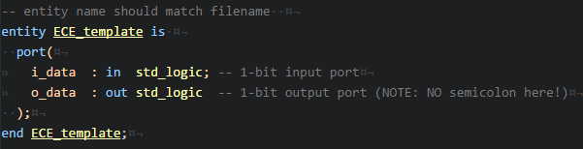
sevenSegDecoder.vhd: Entity
In Ports
Out Ports
sevenSegDecoder.vhd derived from the template file
This is from the template … not this lab!!
You are going to create this entity (left) in the code block above
Follow the example for creating vectors
Remember, this is just a logic decoder and not the actual 8 segment LED

Slide 5
sevenSegDecoder.vhd: Architecture
Now let’s look inside the entity at the architecture:
You will define:
Signals (internal wires)
Logic
Note from below, you can address them differently
Names for elements of vector
i_D(0)
i_D(1)
i_D(2)
i_D(3)
c_Sa
c_Sb
.
.
.
c_Sf
c_Sg
D
.
.
.
S
Your logic here
4
bus
7
bus
vector

Slide 6
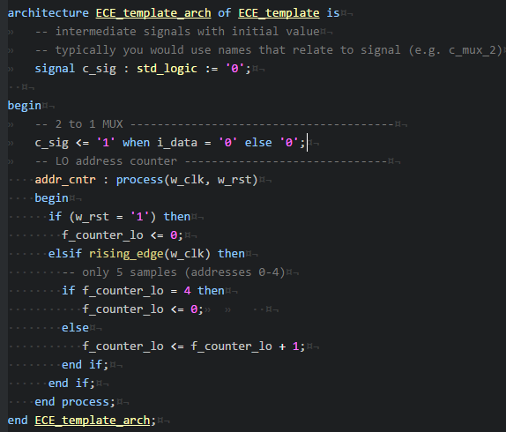
sevenSegDecoder.vhd: Architecture
signal is like a type (int, float, etc)
Follow the lab, but this section will:
Define your intermediate signals and their default values:
signal c_Sa, c_Sb, etc
Signal are wires
Between begin and end, it will define how the entity works using the 2 behavioral examples
Your logic here
This is from the template … not this lab!!

Slide 7

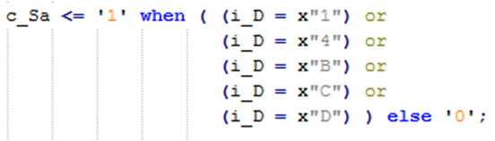
sevenSegDecoder.vhd: Architecture
Behavioral Examples:
SOP (Not, And, Or)
Addressing bits in input vector D
Lookup table
Addressing entire vector
You must do 2 of each kind above and then do the remaining anyway you want

Slide 8
Testbench
signals
signals
o_S(6) => sseg_a
o_S(5) => sseg_b
o_S(4) => sseg_c
…
Similar on this side
LEDs on board
Need to write logic to simulate flipping these switches … just like previous CE’s, this will go between begin and end
sevenSegDecoder_tb.vhd
-------------------------------------
Import libraries
Define ports in/out
Declare external signals (wires)
Map outputs to LEDs
Write test logic

Slide 9
top_Nexys2.vhd
Follow directions in lab to setup and run on hardware.

Slide 10

10

